Slide 1
LESSON 11

Slide 2
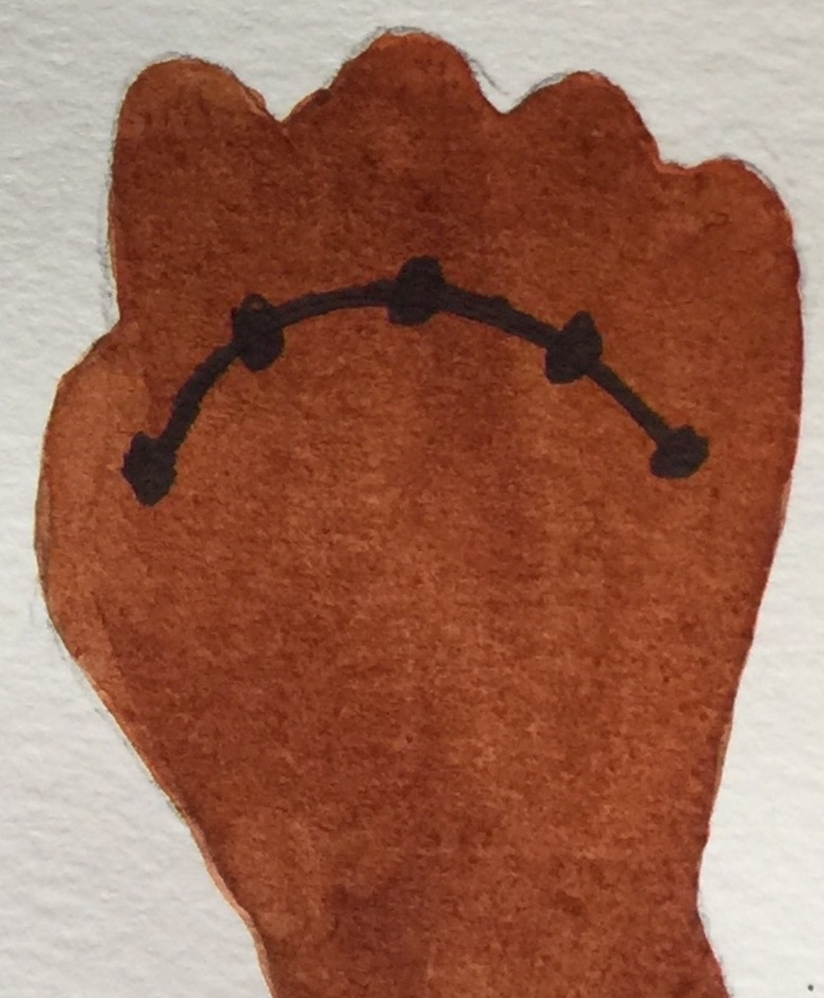

Zero

Slide 3
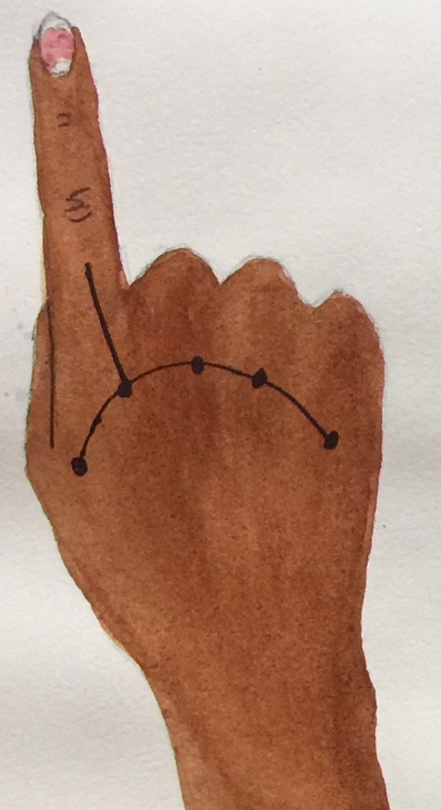
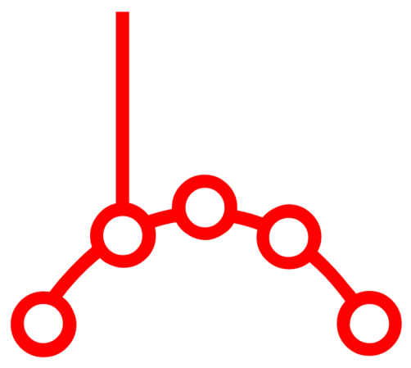
One

Slide 4
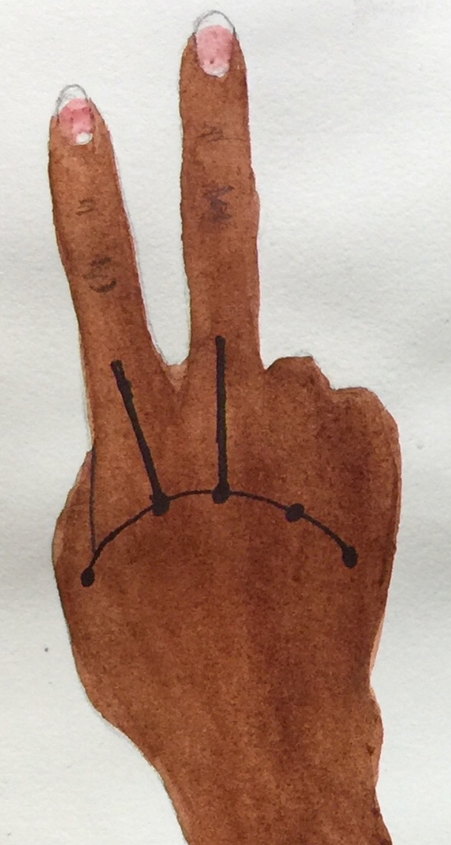

Two

Slide 5
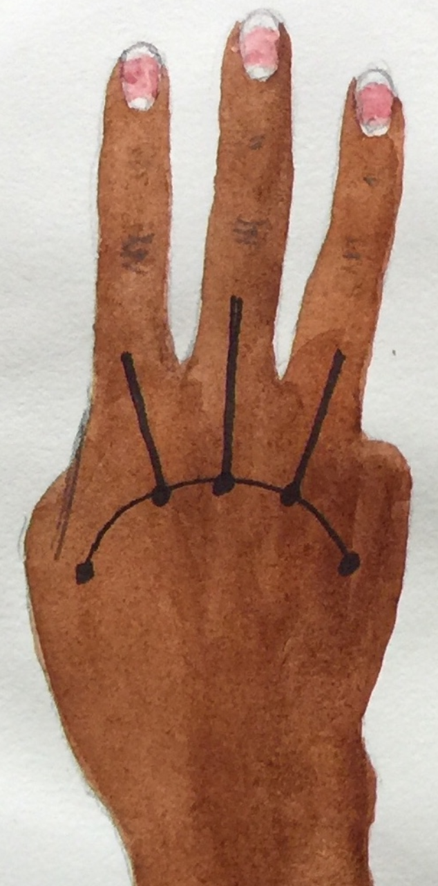

Three

Slide 6
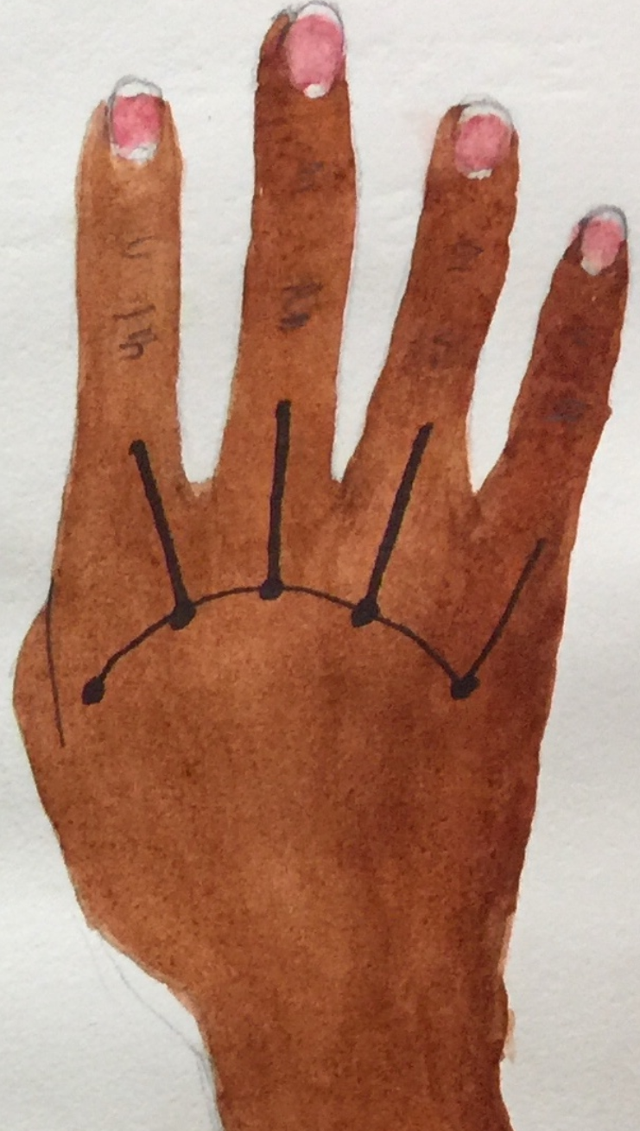

Four

Slide 7
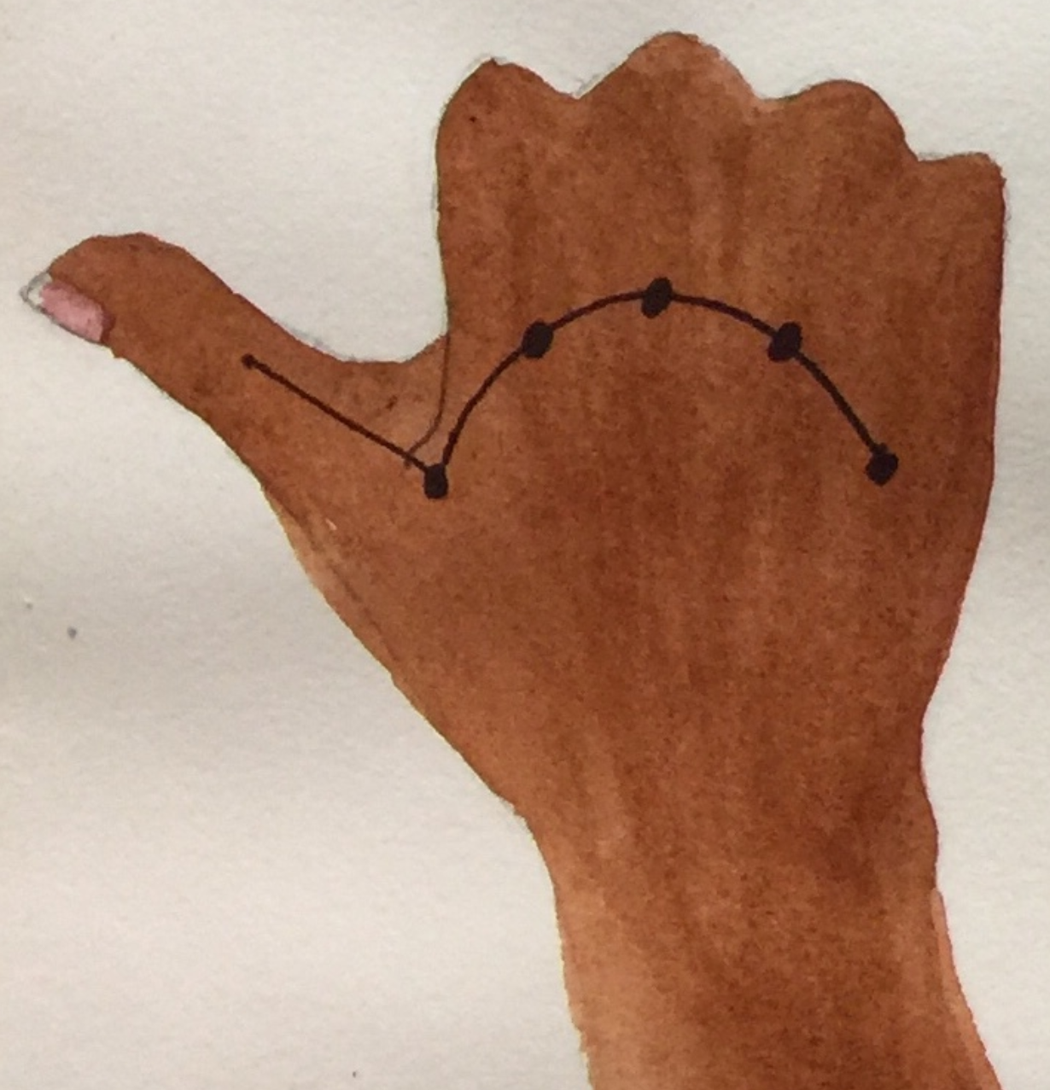
Five

Slide 8
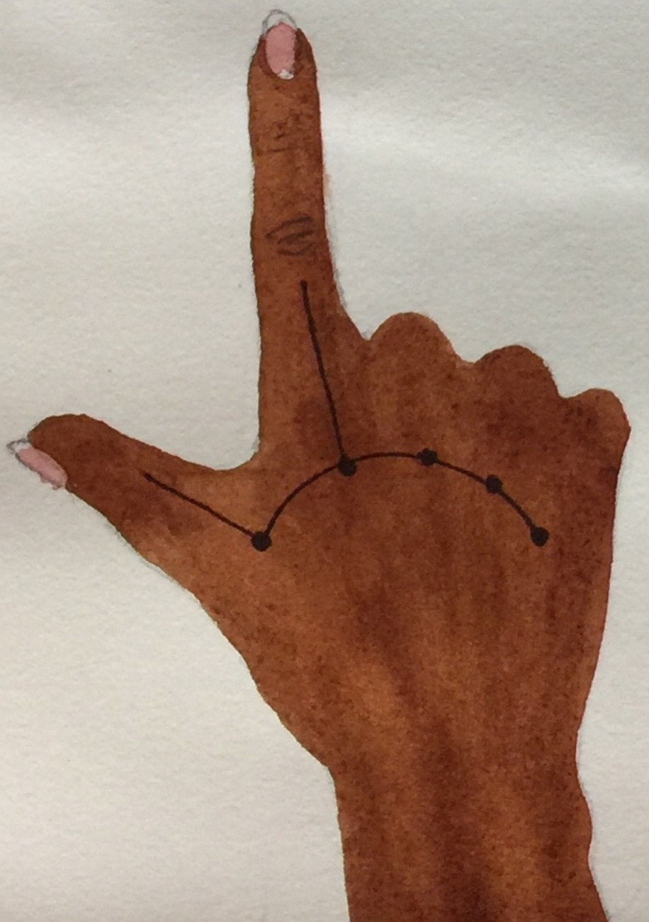
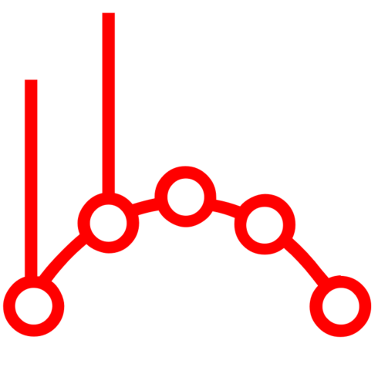
Six

Slide 9
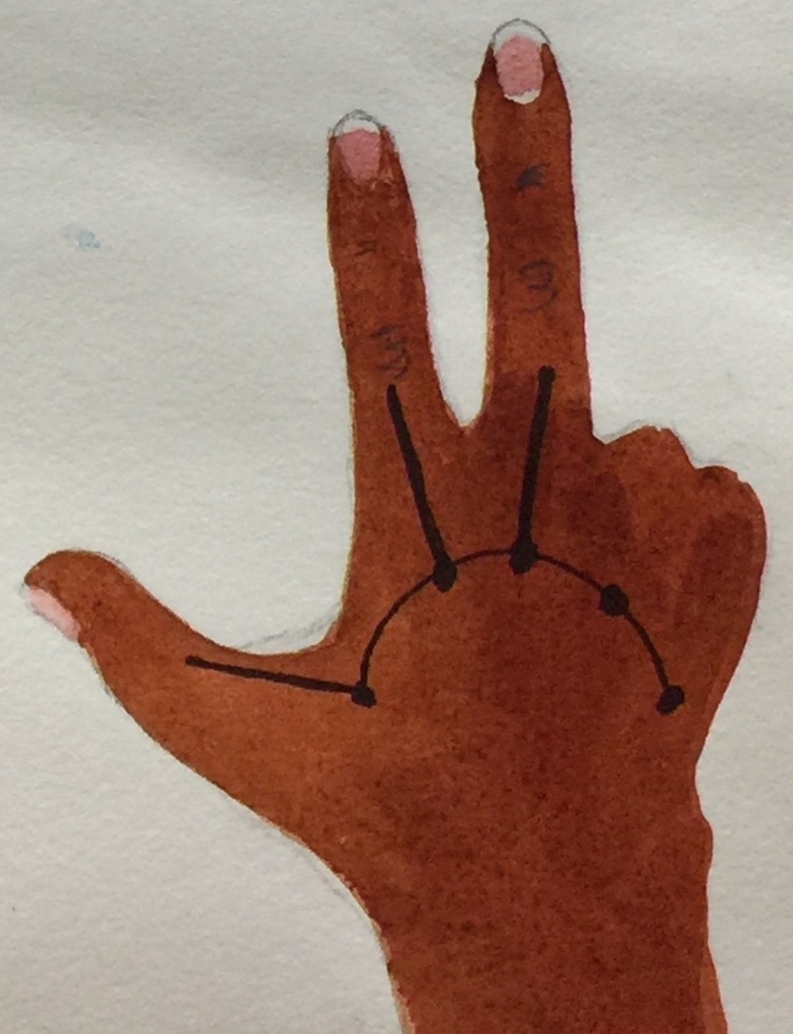
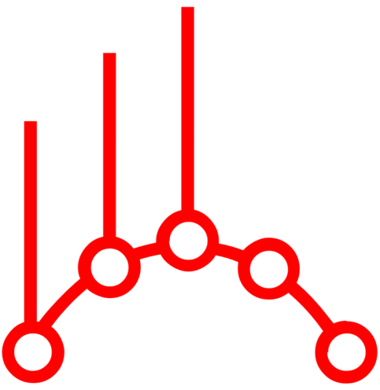
Seven

Slide 10
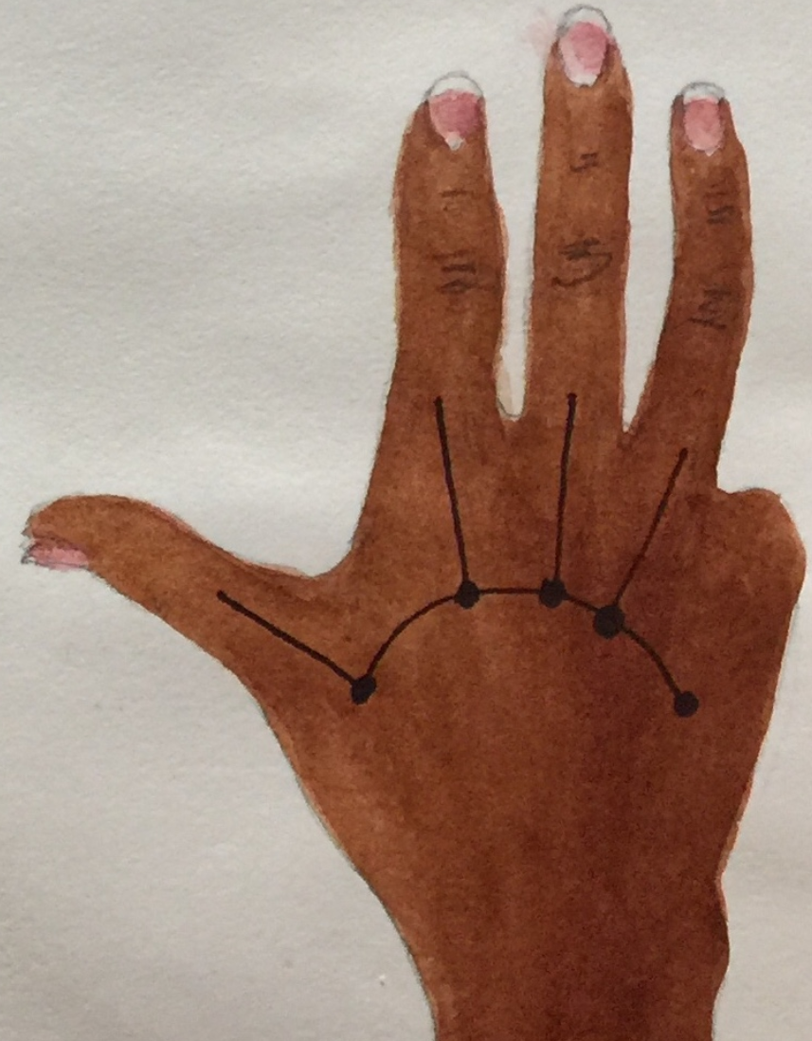

Eight

Slide 11
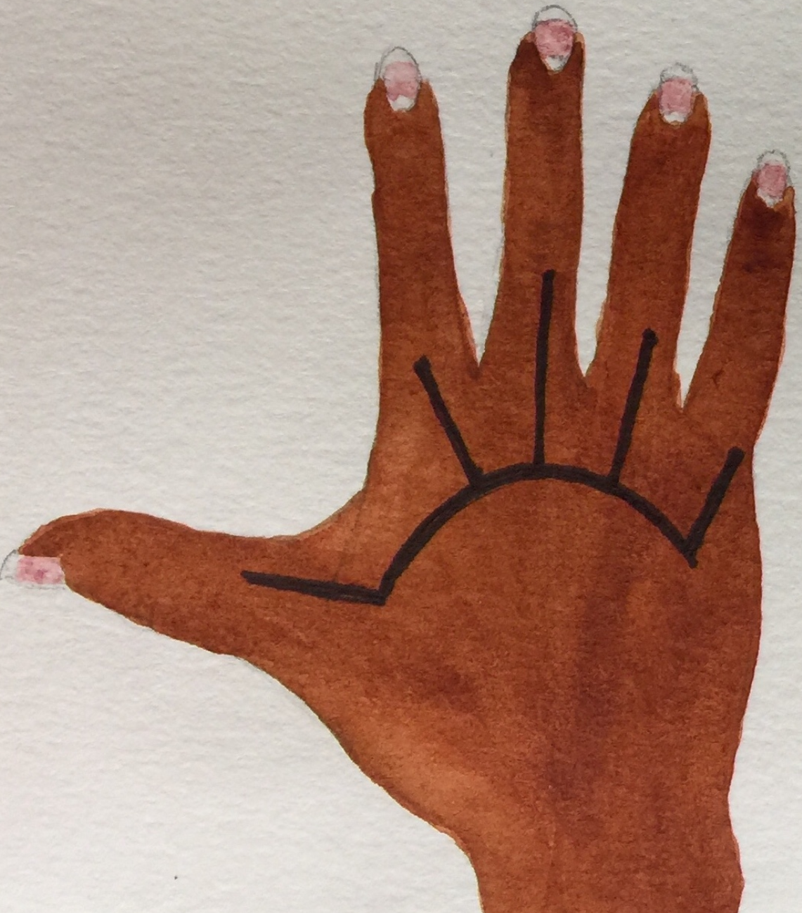

Nine

Slide 12
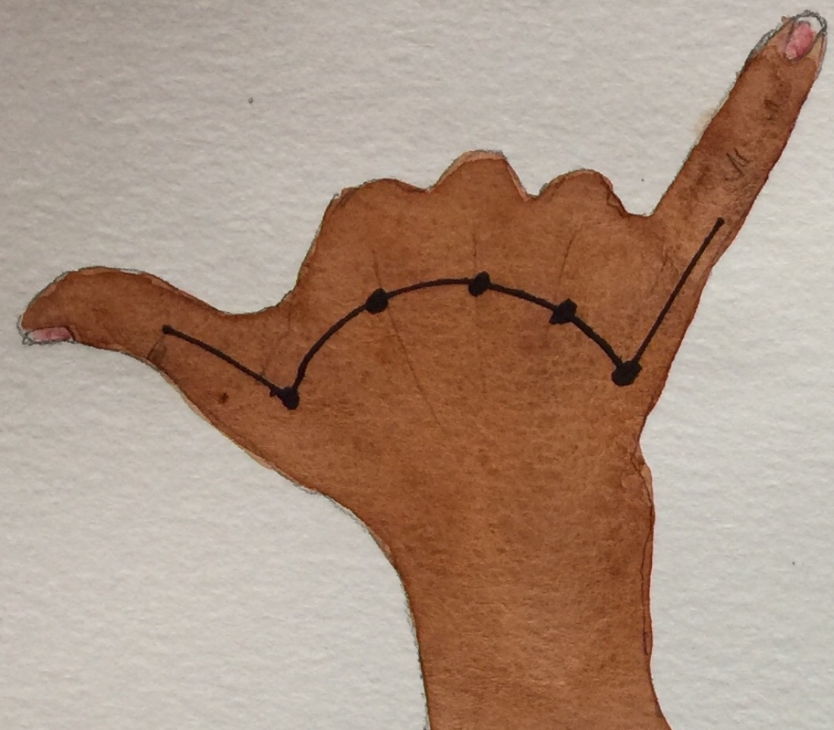
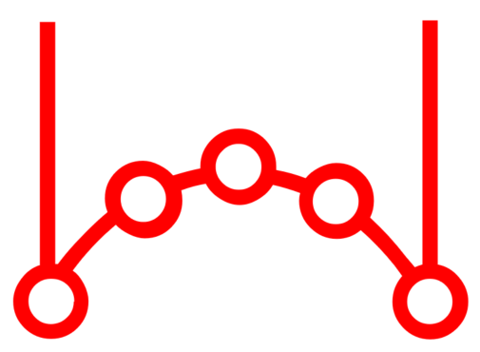
Ten

Slide 13
LESSON 12

Slide 14
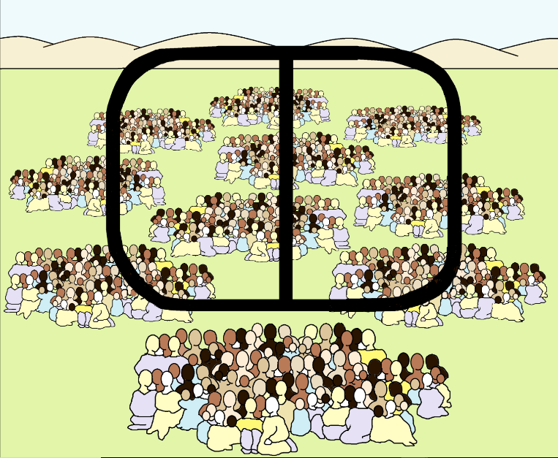

Thousand

Slide 15
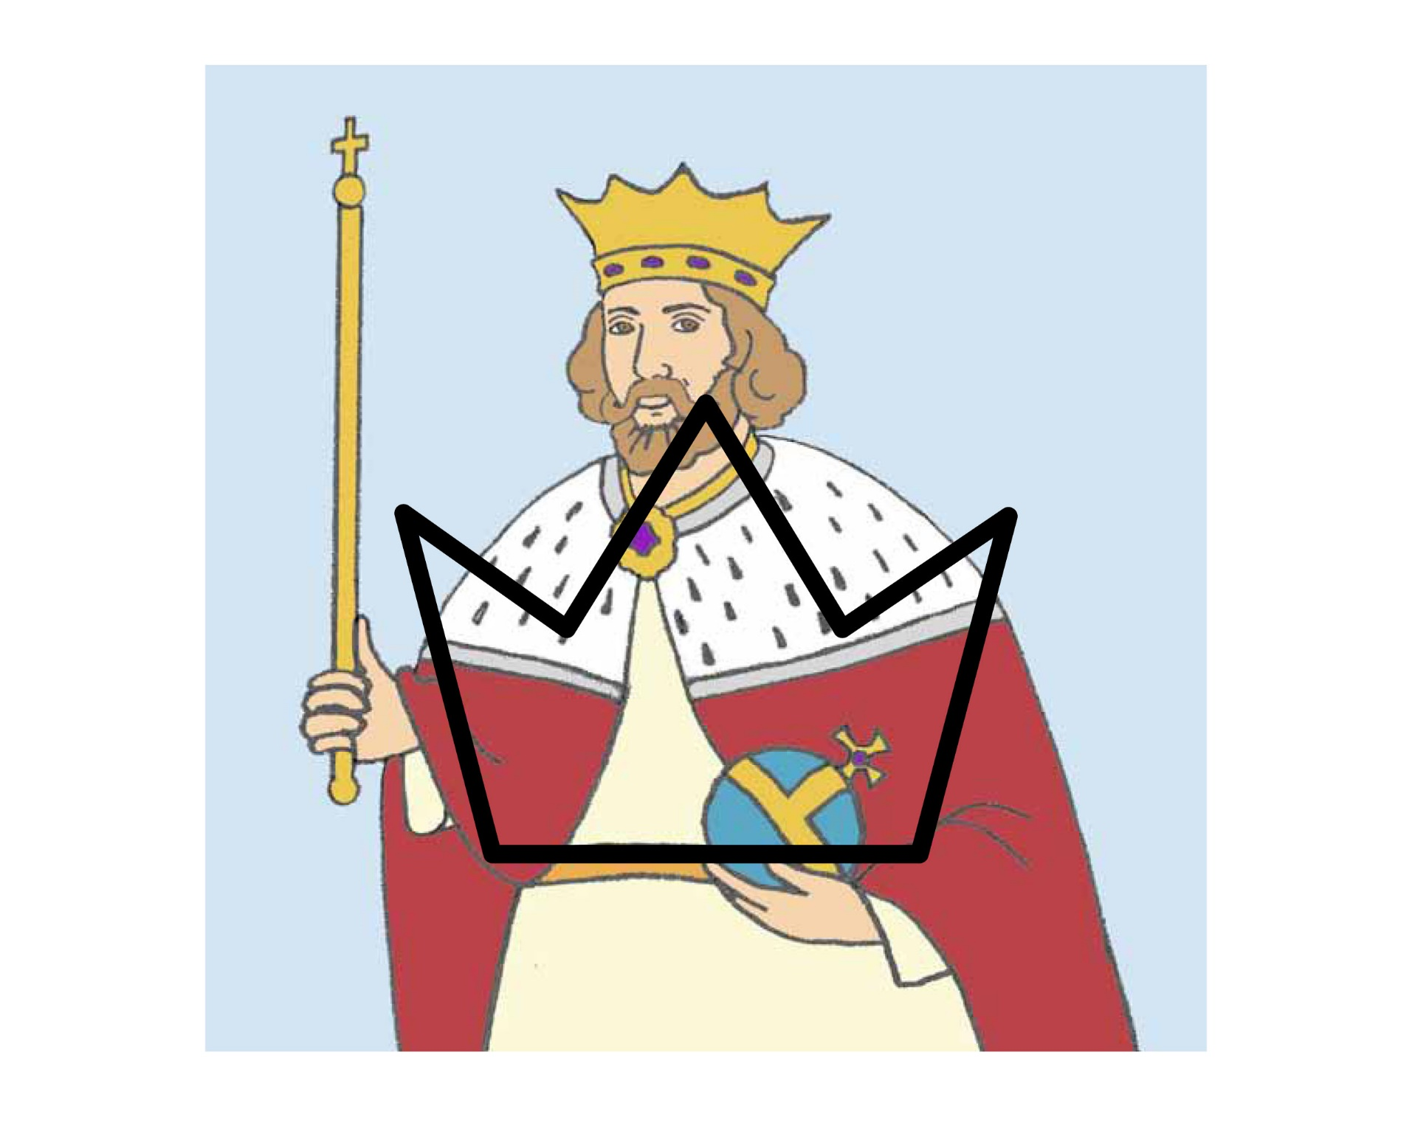

King
Lord
Ruler
Crown

Slide 16


Know
Knowledge

Slide 17
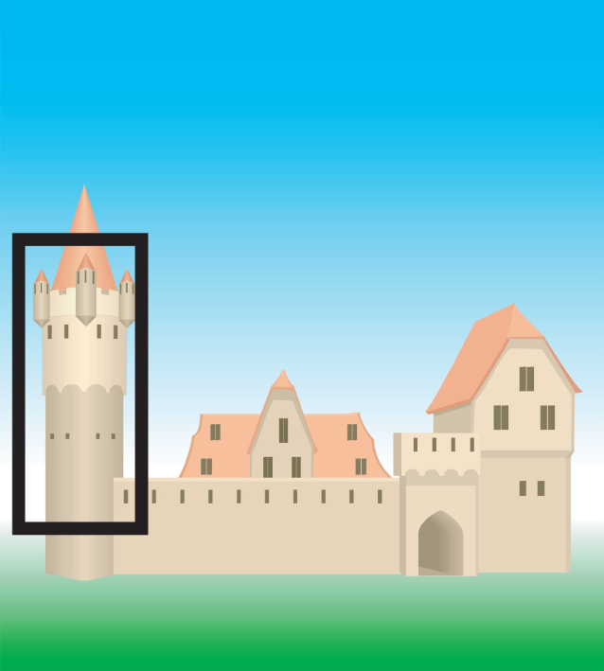

Tower

Slide 18
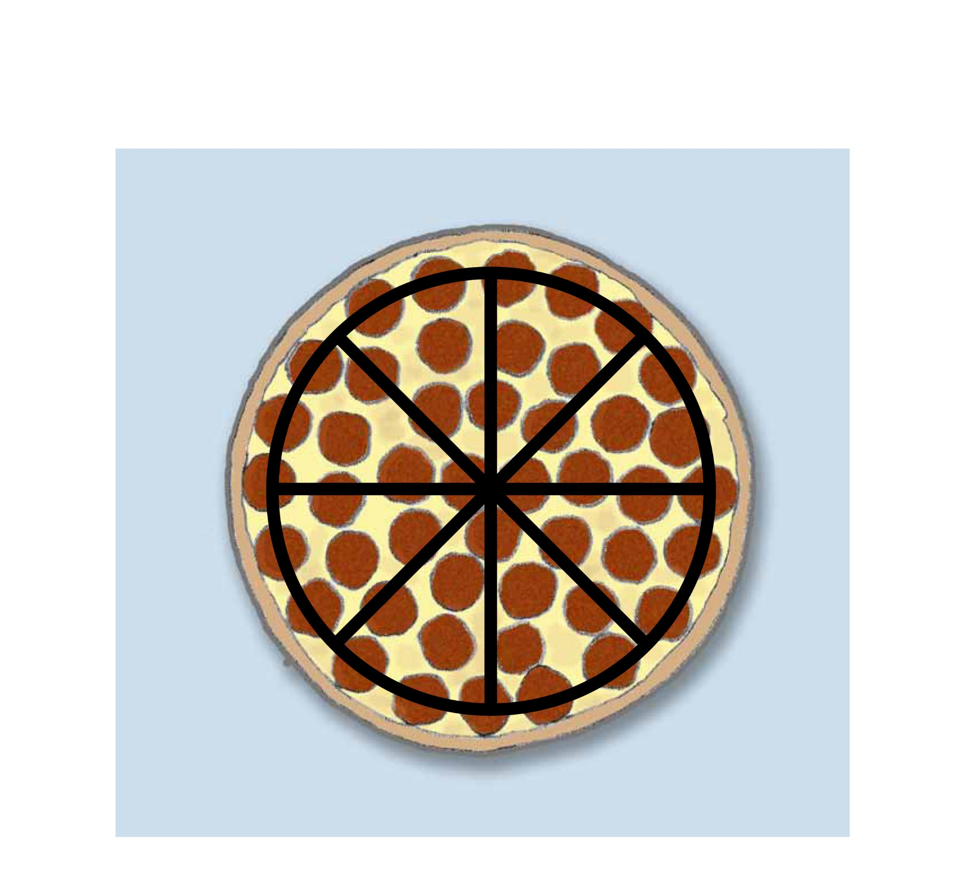
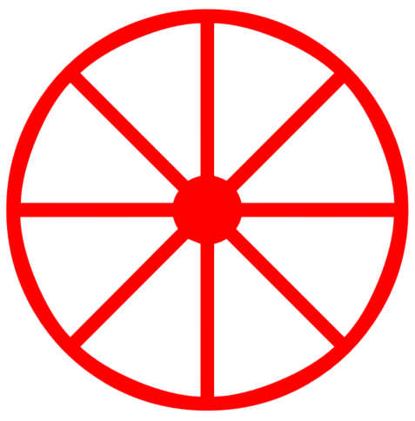
All
Whole
Every

Slide 19
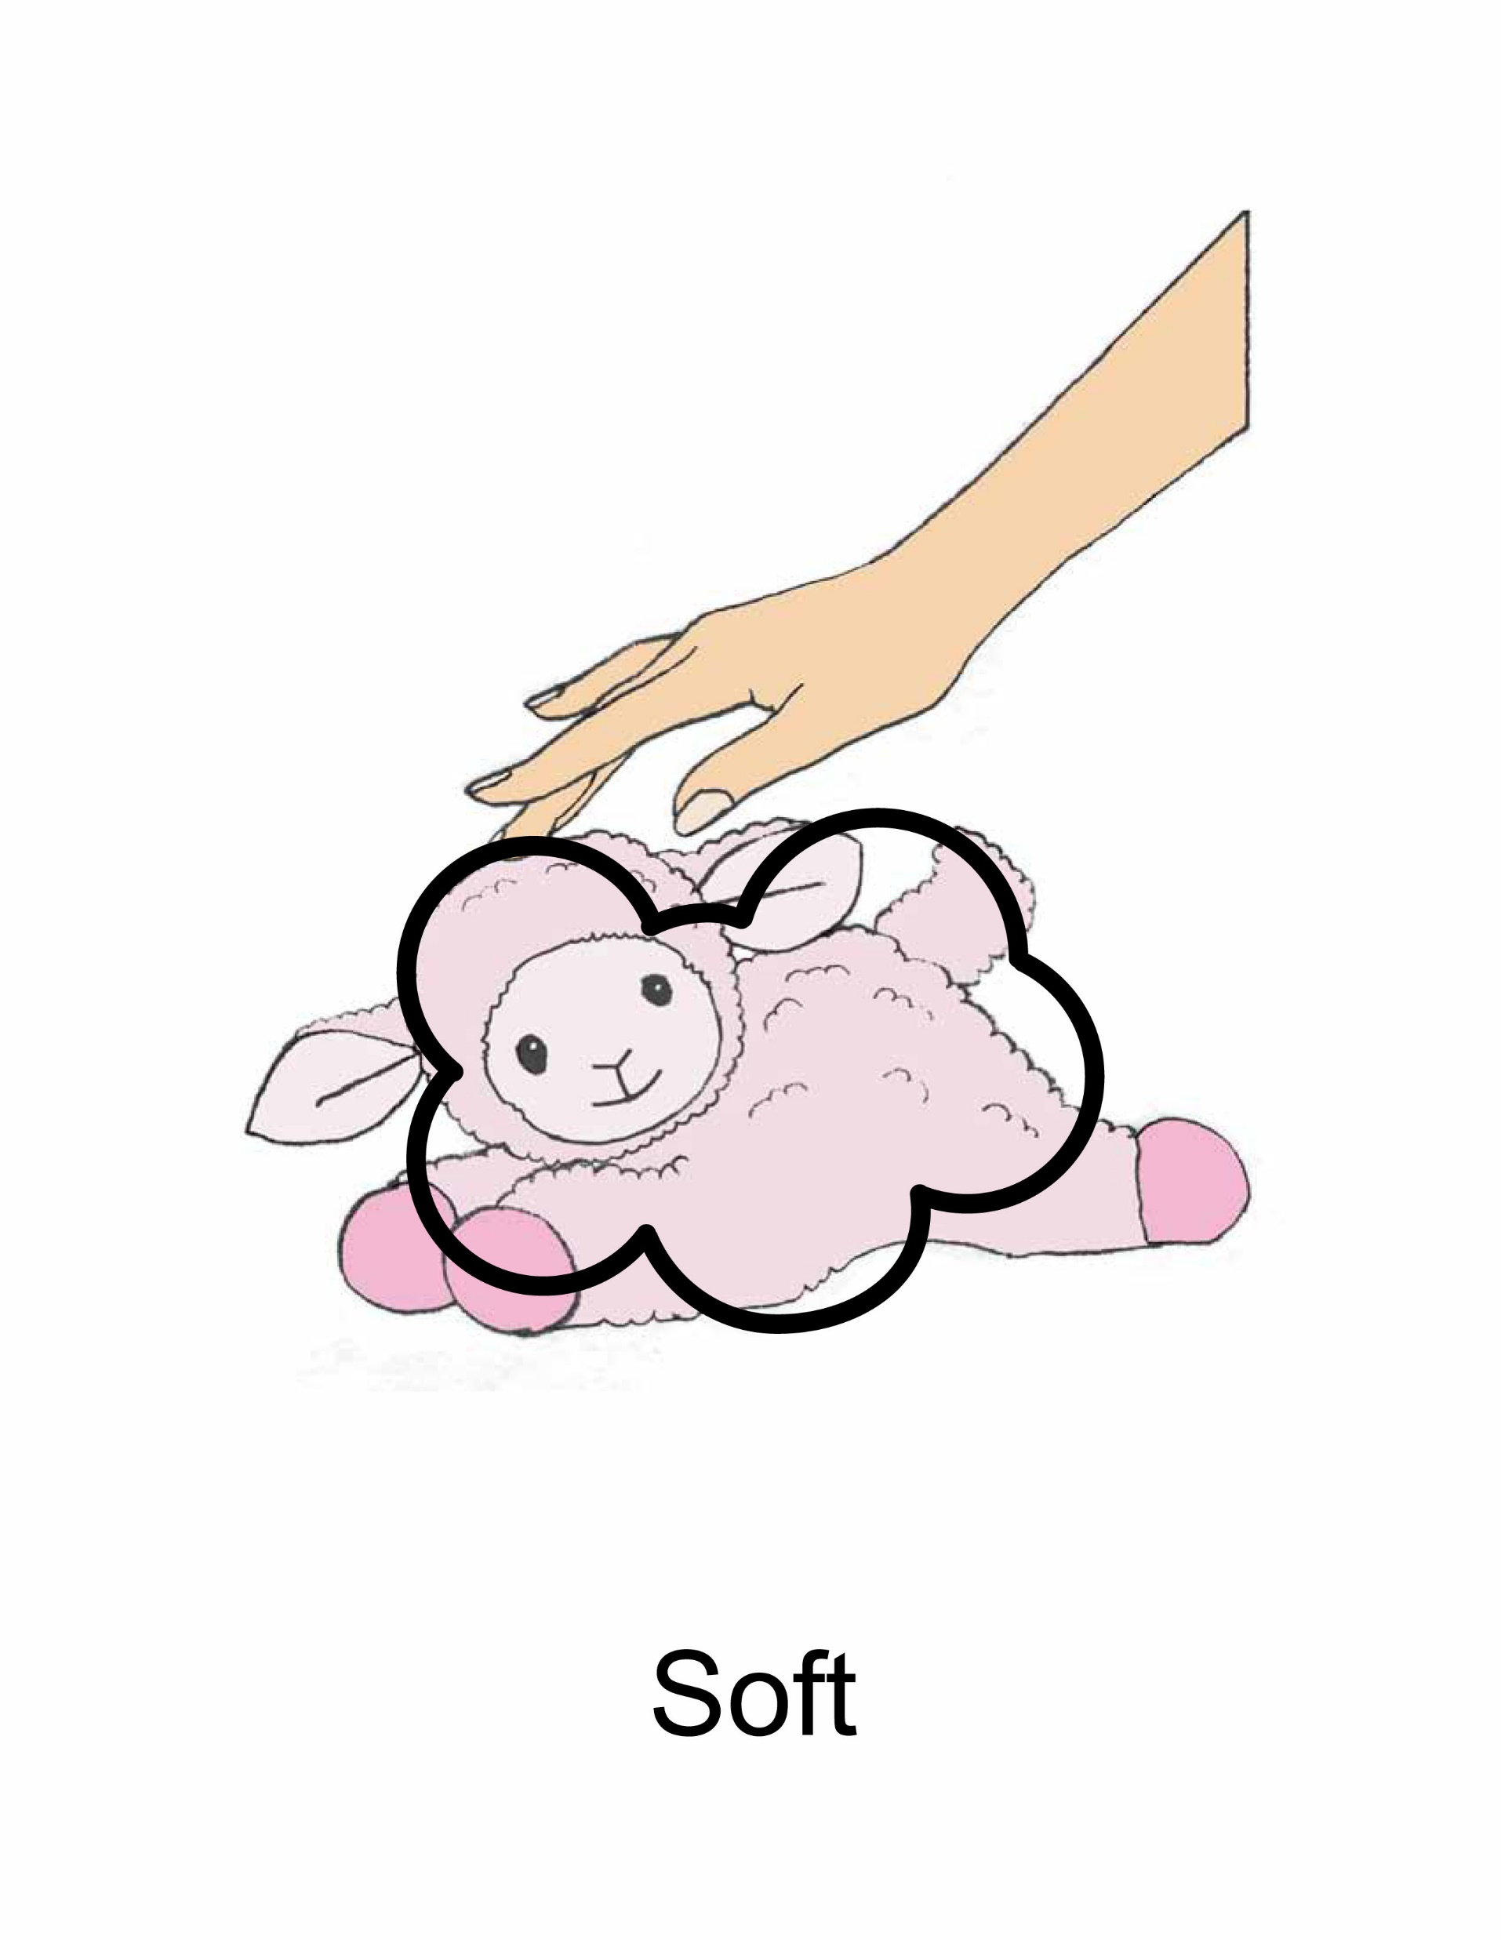

Soft

Slide 20
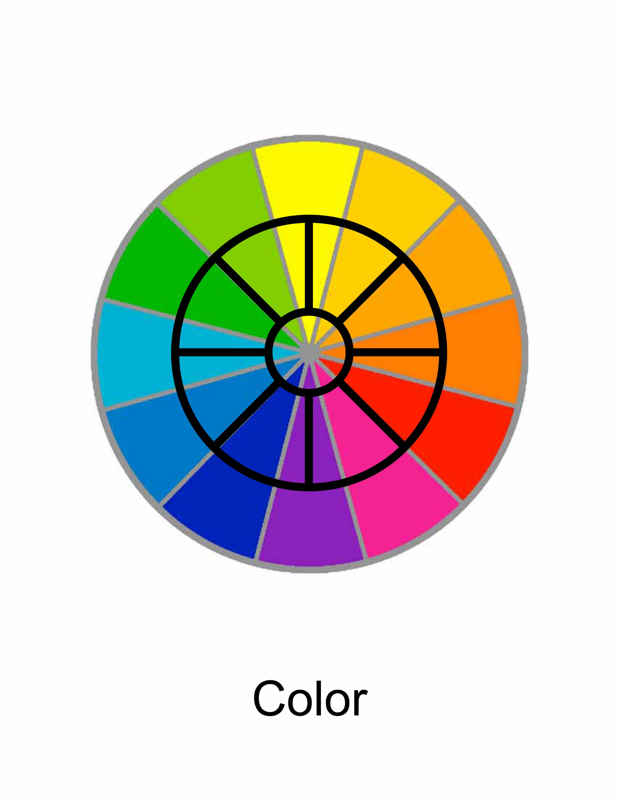

Color

Slide 21
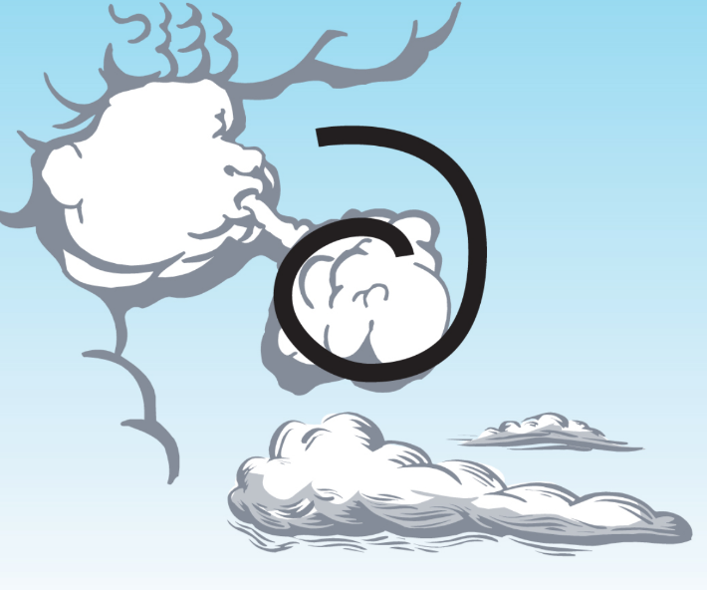

Air

Slide 22
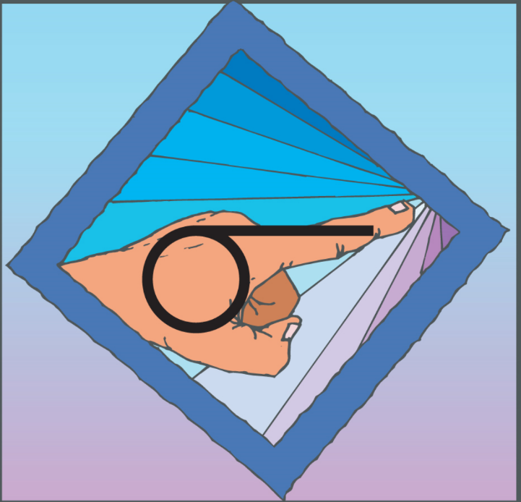
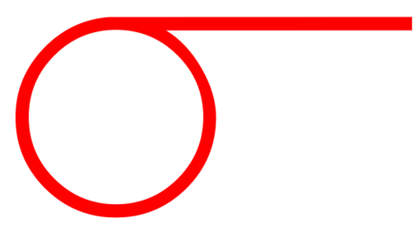
You

Slide 23
LESSON 13

Slide 24
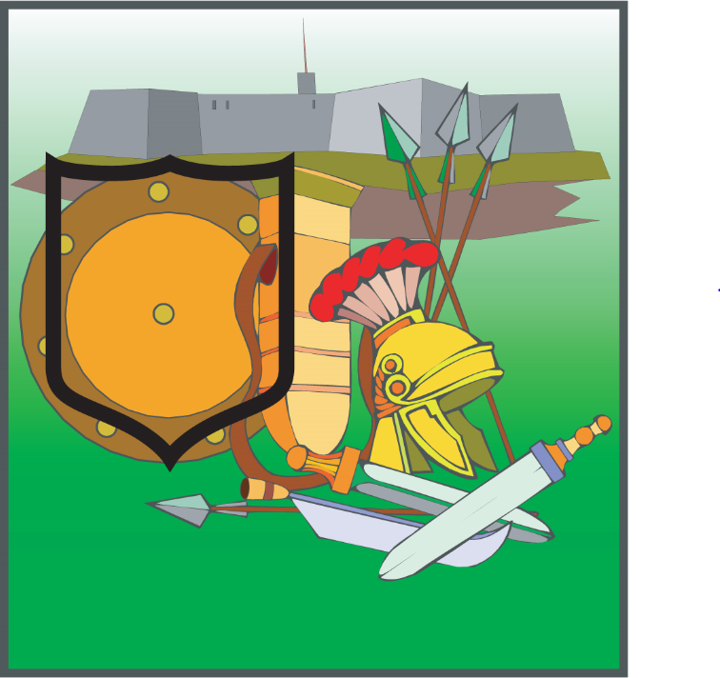

Shield
Protect
Guard

Slide 25
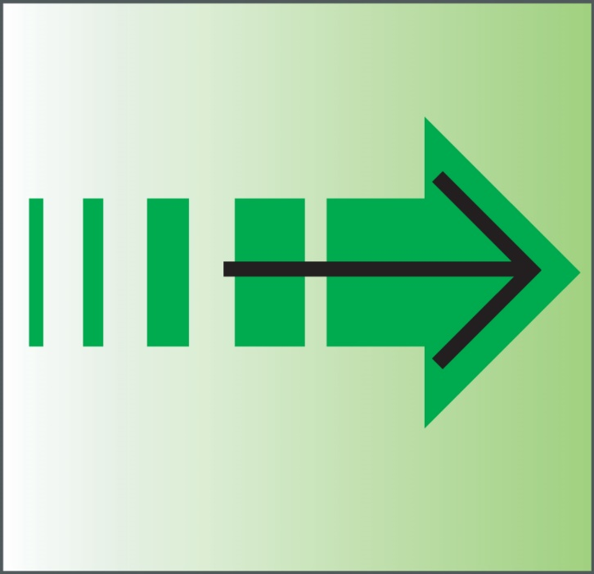
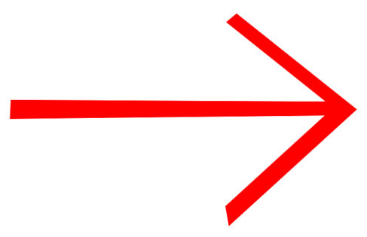
Forward
To

Slide 26
“ “
Quotation Marks

Slide 27
?
Question Mark

Slide 28
!
Exclamation Mark

Slide 29
.
Period

Slide 30
,
Comma

Slide 31
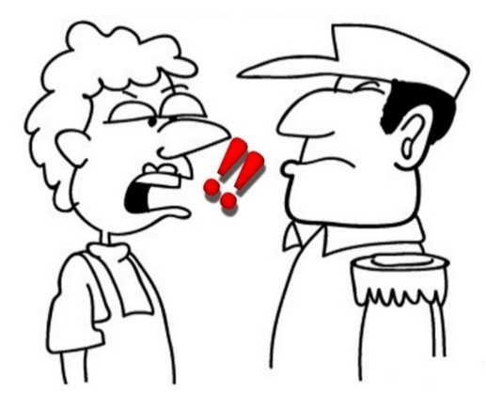

Command
Mouth + Exclamation Point
If you are telling someone emphatically to do something, you are giving a command.

Slide 32


Ask
Questioned
Question Mark + Mouth
A mouth that has a question inside is asking something.

Slide 33
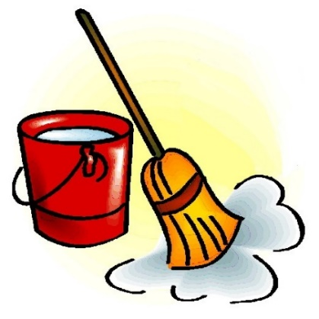

Clean
Good + Water
When you are doing something good with water, you are washing something or making something clean.
.

Slide 34
LESSON 14

Slide 35
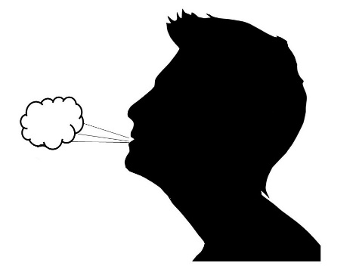

Sigh
Mouth + Air
A sigh is the sound you make when air comes out of your mouth.

Slide 36
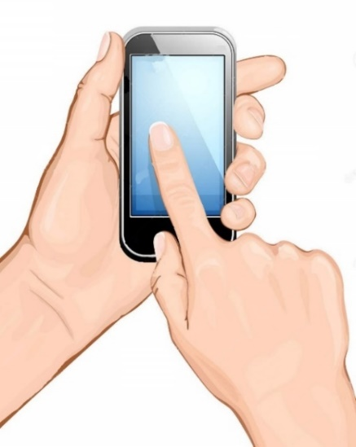

Touch
Hand touching a thing.

Slide 37
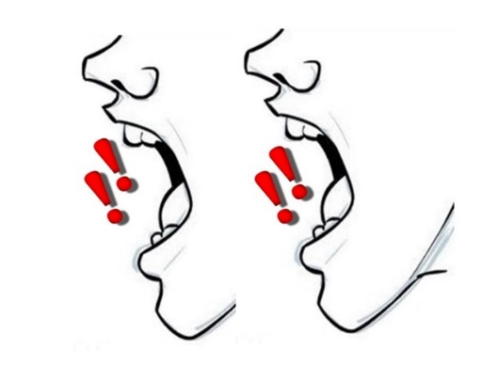

Repeat
Two Mouths
When you have to say something over and over again, you are repeating it.

Slide 38


Mute
Mouth + No
When there is nothing coming out of a person’s mouth, that person is mute.

Slide 39
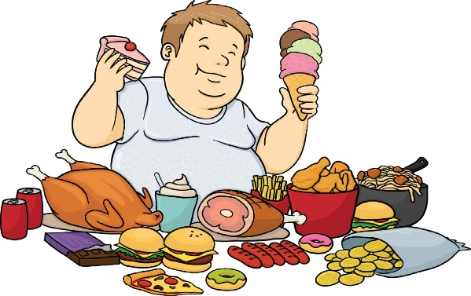

Feast
Big + Eat
You eat a lot at a feast.

Slide 40
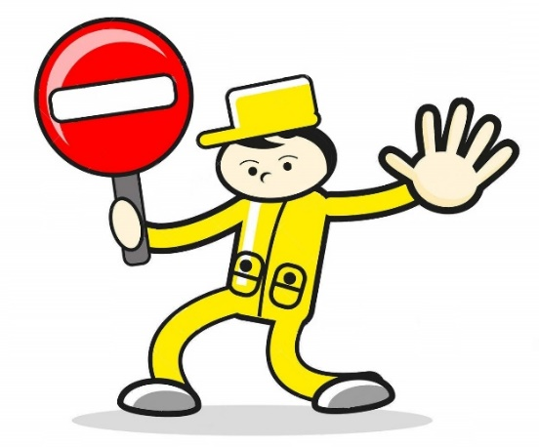

Stop
Hand + End
When you use your hand to end something, you are stopping it.

Slide 41
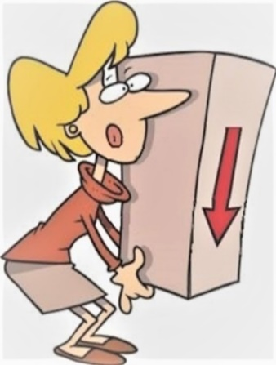

Lower (verb)
Hand + Down
When you are using your hand to bring something down, you are lowering it.

Slide 42
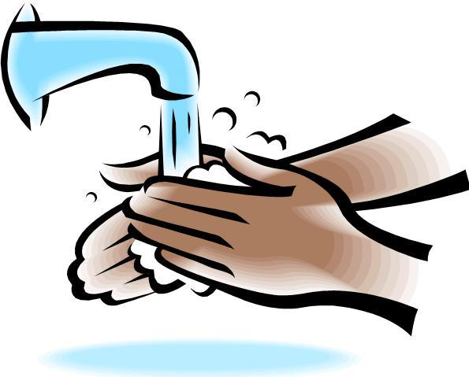

Wash
Hand + Clean
When you make something clean with your hand, you are washing it.

Slide 43
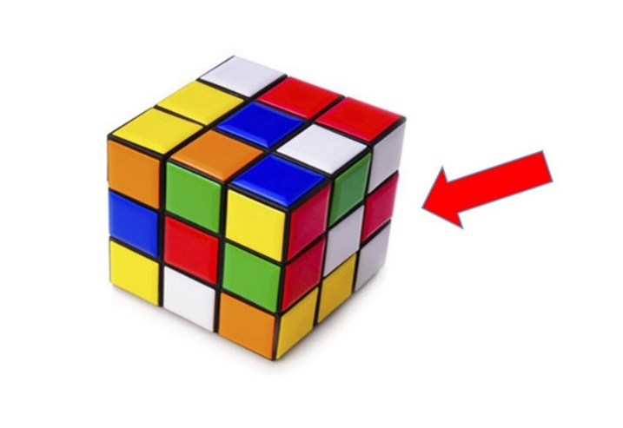
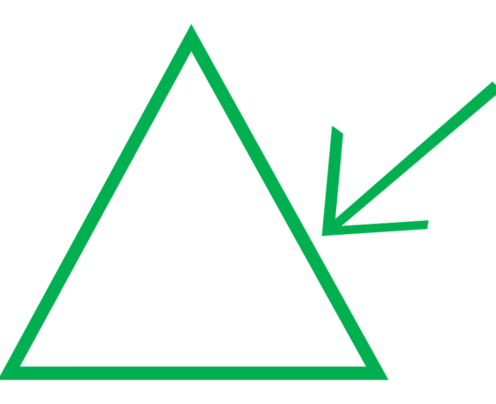
Side
Thing + Arrow
Pointing to the side of the thing.

Slide 44
LESSON 15

Slide 45

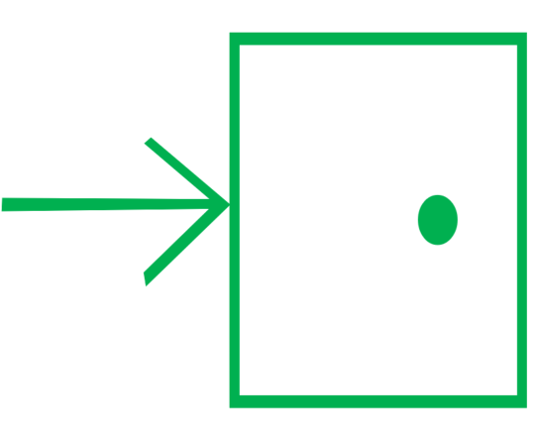
Enter
Come In
The arrow is entering or going into the door.

Slide 46
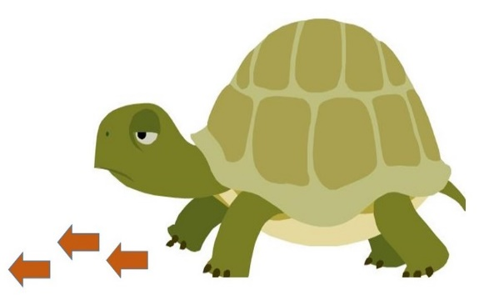

Slow
Little + Forward
When you are moving forward little by little, you are moving slow.

Slide 47
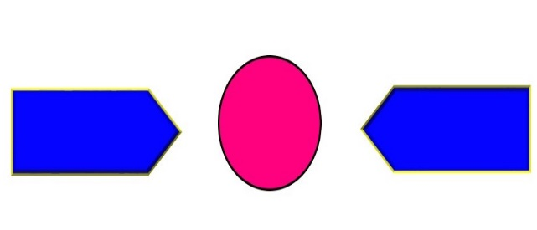

Between
Thing in between two lines.

Slide 48
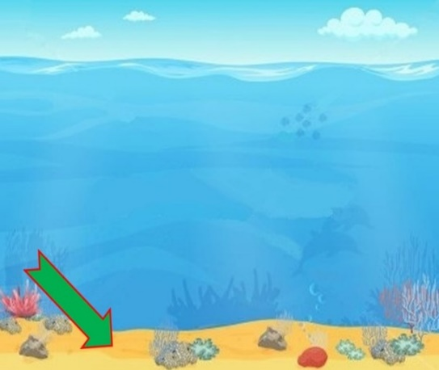

Bottom
Thing with an arrow pointing to the bottom of the thing.

Slide 49
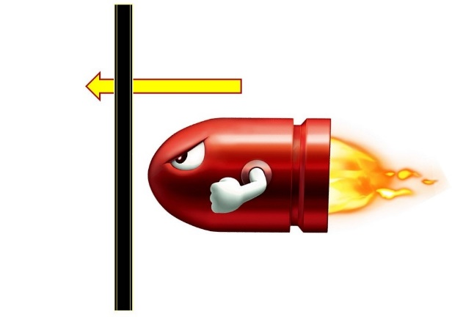
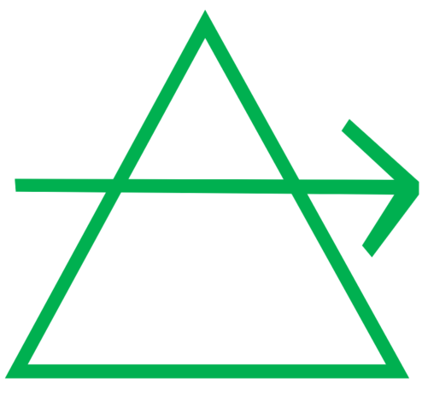
Through
Thing + Arrow going through the thing.

Slide 50
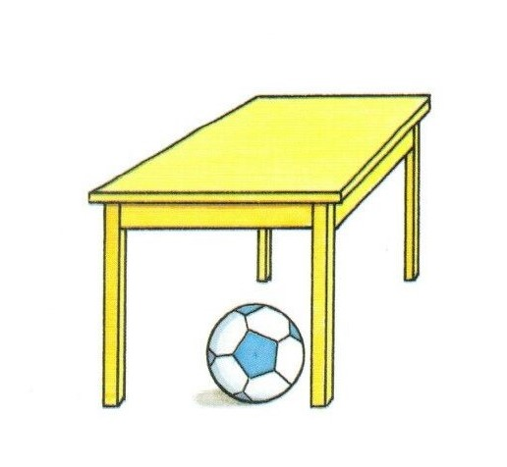
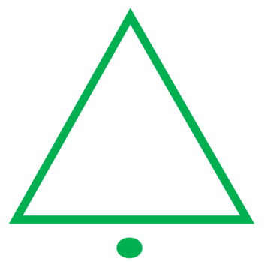
Under
Thing + Dot under the thing

Slide 51
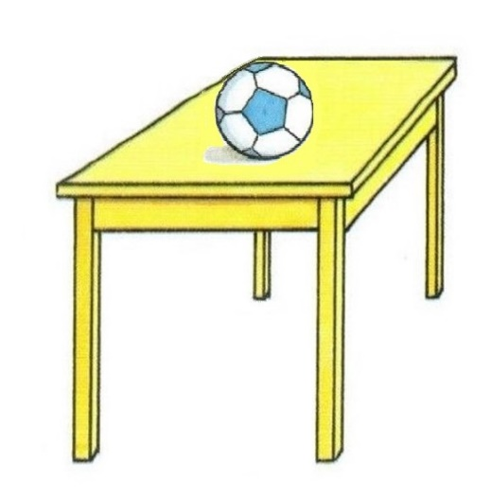

Above
Over
Up + Thing

Slide 52
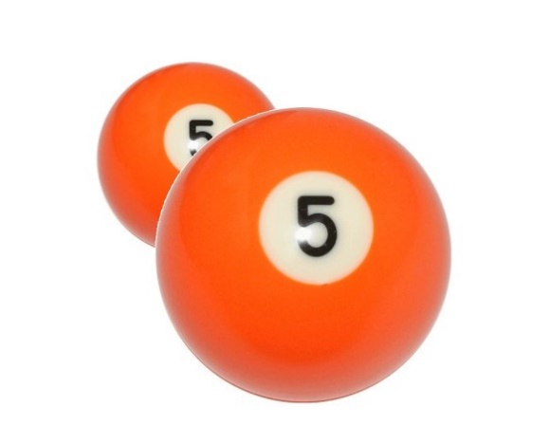

Front
In Front Of
Big thing in front of small thing.

Slide 53
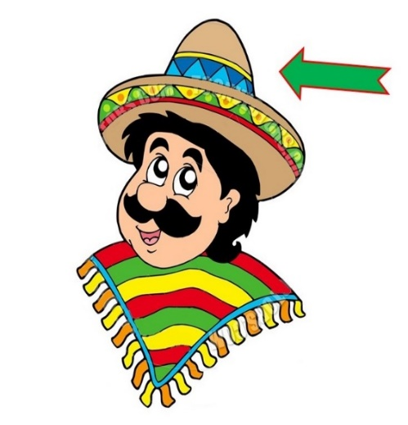

On
On top of
Thing + Arrow pointing to the top of the thing.

Slide 54


Behind
Little thing with big thing behind it.

Slide 55
LESSON 16

Slide 56


Body
Person with a circle around him.
The circle indicates it is talking about the person’s body.

Slide 57


Lamp
Sun + Thing
When light (sun) is coming from an object, that object is a lamp.

Slide 58


Lift
Raise
Hand + Up
When you use your hand to bring something up, you are lifting or raising it.

Slide 59


Before
Backward + Thing
A thing with an arrow pointing backward indicating what happened before the thing.

Slide 60


After
Thing + Forward
The arrow is moving past the thing. It shows what is coming after the thing.

Slide 61


Away
Thing + Arrow going away

Slide 62


Them
They
3 people
They is a pronoun that represents a group of people.

Slide 63


Shoe
Sandal
Person + Thing on foot
A shoe or sandal is a thing that goes on a person’s foot.

Slide 64


Follow
Person moving in the same direction as another person
When a person is moving in the same direction as the person in front of him, he is following.

Slide 65
LESSON 17

Slide 66


Everyone
All + Person
When you are referring to all people, you are referring to everyone.

Slide 67


Kill
Destroy
Knife + Person
When you aim a knife at a person, you are probably trying to kill him or destroy him.
.

Slide 68


Crush
Person + Thing under foot
When there is an object under your foot, you are probably going to crush it

Slide 69


To Clothe
Fabric + Person
When a piece of fabric is put on a person, that person is clothed.

Slide 70


Shout
Cry Out
Big + Mouth
When you open your mouth very big, you are shouting.

Slide 71


Grow
Growth
Land + Up
When things come up out of the land, it is growing. This symbol also refers to spiritual growth.

Slide 72


Wilderness
Desert
Land + No + Tree
A wilderness or a desert often has no trees or very few trees.
.

Slide 73


Soil
Dirt
Land + (Squiggly line underneath)
The squiggly line represents the soil which is underneath the land.

Slide 74


Root
Land + Lines showing what is growing under the land
A root is the part of the plant that grows underground.

Slide 75


Year
Land (Earth) going around Sun
A year is the amount of time it takes for the Earth to go around the sun one time.

Slide 76
LESSON 18

Slide 77


Part
Some

Slide 78


Sunset
Sundown
Sun + Down
Sunset is the time when the sun goes down.

Slide 79


Morning
Sun Over a Line
Morning is when the sun is just coming up over the horizon (line).

Slide 80


Us
We
2 I’s
When I use the word “us,” I am talking about more than one person including me.
.

Slide 81


Dust
Small + Part + Land
Dust are small particles on the land.
.

Slide 82


Our
Ours
We + Possessive Dot
When we possess something, we say it is ours.

Slide 83


Winter
Time + No + Heat
Winter is a time when it is not hot.
.

Slide 84


Slide 85

In
Inside
Thing + Door
This shows a thing inside a door.

Slide 86
LESSON 19

Slide 87


Time

Slide 88


Past
History
Backward + Time
The time before now is the past or history.

Slide 89


Future
Time + Forward
The time that is ahead is the future.

Slide 90


Quiet
No + Mouth
When your mouth is not talking, you are quiet.

Slide 91


Deaf
No + Ear
If your ear does not work, you are deaf.

Slide 92


Blind
No + Eyes
When your eyes are not working, you are blind.

Slide 93


Bad
No + Good
If something is not good, it is bad.
.

Slide 94


Whisper
Secret
Quiet + Ear
When someone whispers something quietly into your ear, he is telling you a secret.

Slide 95


Skull
Head with arrow pointing inside the head.
The skull is the bone inside the head.
.

Slide 96


Put
Hand + Thing
This hand is facing downward putting an object down on a table or floor.

Slide 97
LESSON 20

Slide 98


Freed
Free
Chain + No
When you are free, you are not chained.

Slide 99


Closed
Doors together
When doors are touching each other, the entrance is closed.

Slide 100


Slide 101


Crowd
Multitude
Four People
Four people represents a lot of people, which is a crowd or multitude.

Slide 102


Jesus
King + Cross
Jesus is the King on the cross.

Slide 103


God
King + Father
God is King and Father of Jesus Christ and those who believe in Jesus.

Slide 104


Heaven
House + God
Heaven is God’s house.

Slide 105


Love
Compassion

Slide 106


Desire
Will
Want
Love + Heart
When your heart loves something, you desire it.

Slide 107


Beg
Plead
Very + Mouth + Desire
When you are emphatically talking about something you desire, you are begging.

Slide 108

Notes:
They brought to Jesus someone who was deaf and had difficulty speaking.

Slide 109

Notes:
They begged Jesus to lay his hand on him.

Slide 110

Notes:
Jesus took him aside from the crowd privately.

Slide 111

Notes:
Jesus put His fingers into his ears.

Slide 112

Notes:
After spitting

Slide 113

Notes:
Jesus touched his tongue.

Slide 114

Notes:
Jesus looked up to Heaven.

Slide 115

Notes:
Jesus sighed.

Slide 116

Notes:
Jesus said to him “ Ephphatha, “ that is to say, “Open!”

Slide 117

Notes:
Immediately his hearing was opened.

Slide 118

Notes:
His tongue was loosened. What prevented his tongue was destroyed.

Slide 119

Notes:
He could speak clearly.

